Slide 2
Head Start Performance Standard
DECA = Behavioral Screener
1302.33 Child screenings and assessments.
Screening.
(1) In collaboration with each child’s parent and with parental consent, a program must complete or obtain a current developmental screening to identify concerns regarding a child’s developmental, behavioral, motor, language, social, cognitive, and emotional skills within 45 calendar days of when the child first attends the program or, for the home-based program option, receives a home visit. A program that operates for 90 days or less must complete or obtain a current developmental screening within 30 calendar days of when the child first attends the program.
(2) A program must use one or more research-based developmental standardized screening tools to complete the screening. A program must use as part of the screening additional information from family members, teachers, and relevant staff familiar with the child’s typical behavior.

Slide 3
Step 1: Log in to www.e-deca2.org
*Each teacher is responsible fro their own username and password

Slide 4
Step 2: To input ratings click on “Input Ratings” then click on “ By Child”

Slide 5
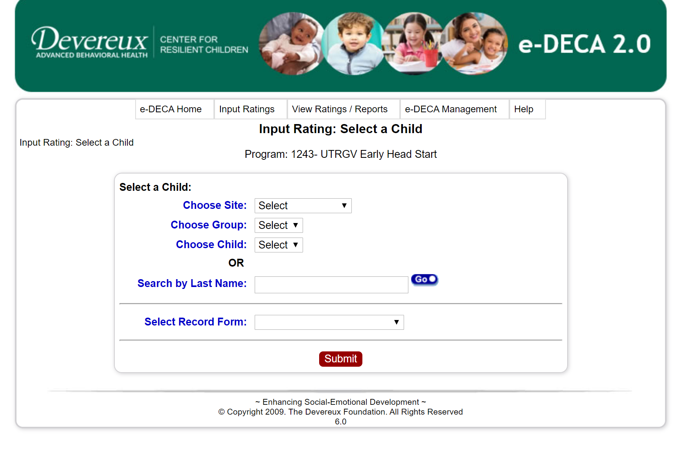
Step 3: Select Site (campus) group (classroom) and child’s name then select the appropriate Record Form that will be conducted (Infant or Toddler record)
Hit “Submit”

Slide 6
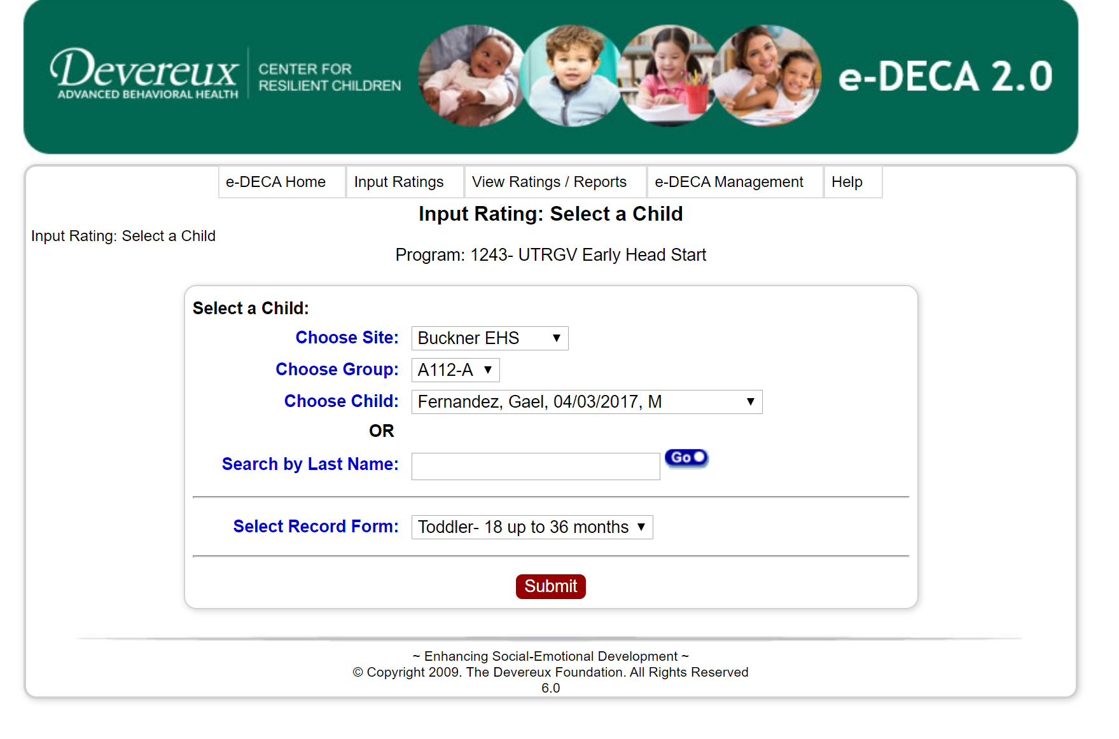

Slide 7
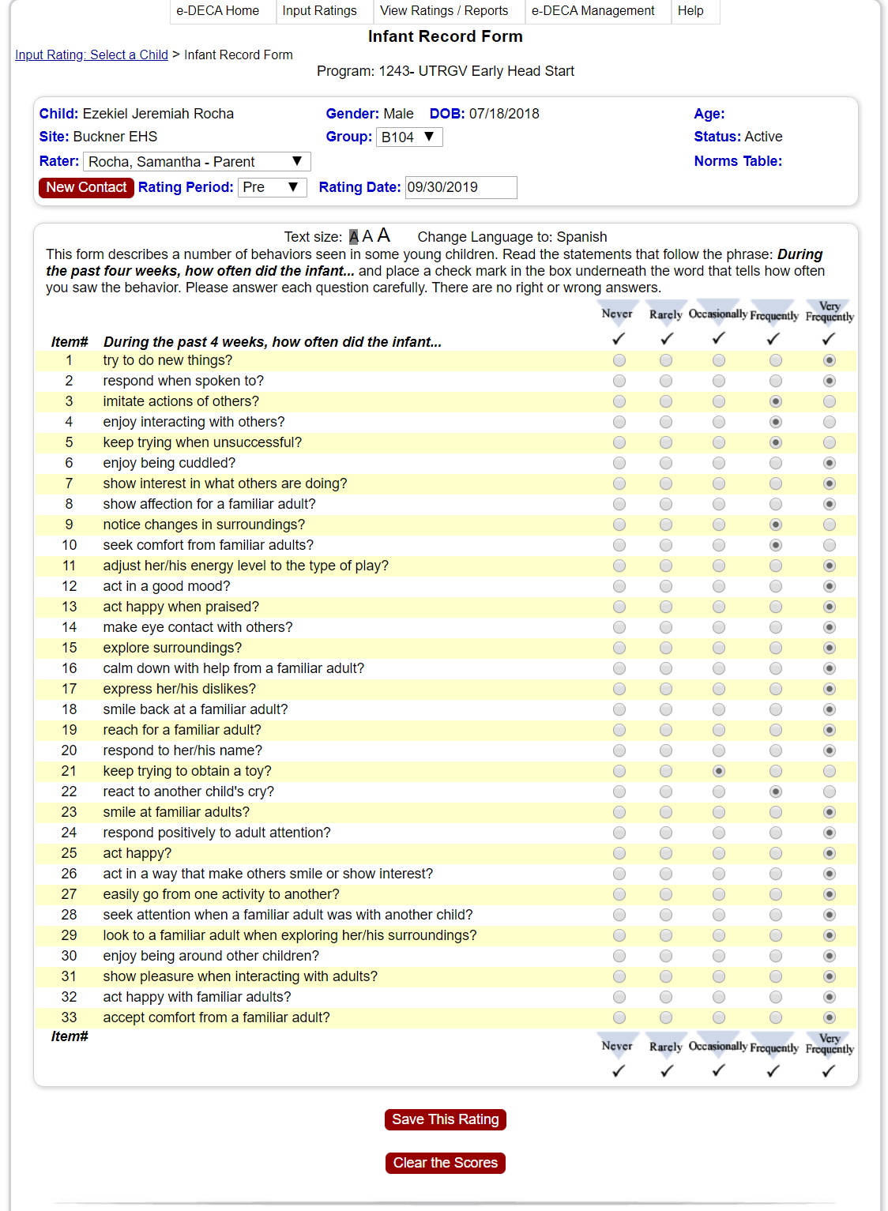
Step 4
Ensure you are completing the correct form (check age)
Review the information with:
child’s name,
date of birth,
group (classrooms #)
parents name (rater)
Go over each question with parent via phone conference and bubble each answer according to what parent answers.
Click on “Save Rating”

Slide 8
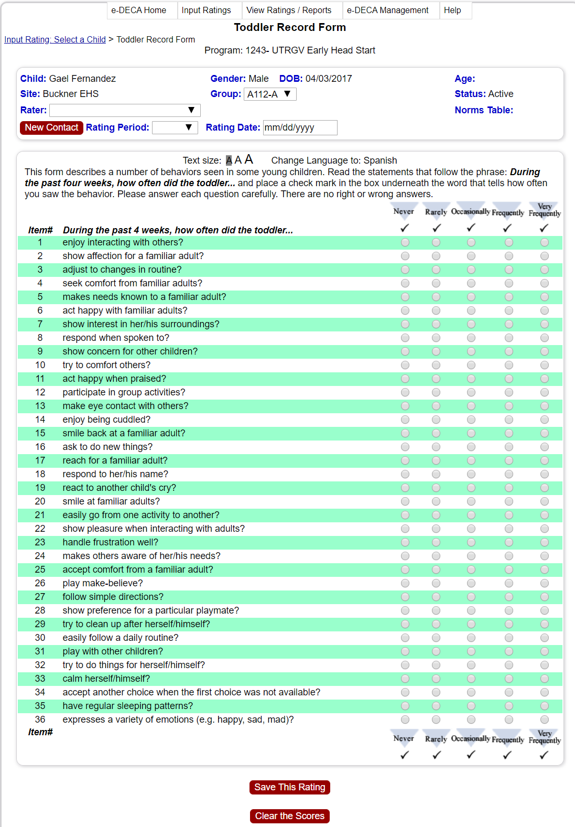
Toddler Record Form (green)

Slide 9
Step 5: Click on “Display Scores and Single Rating Report

Slide 10
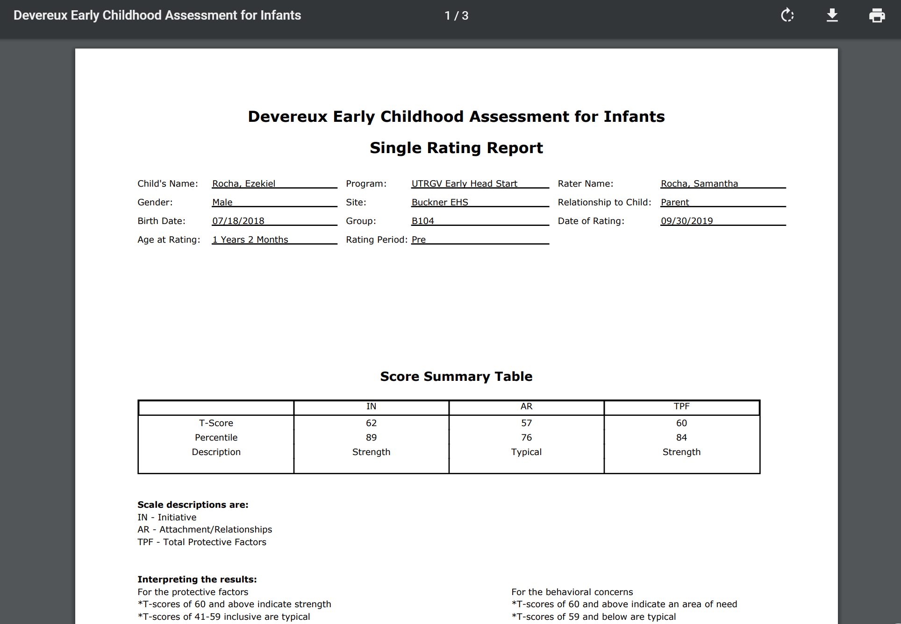
You will receive 2-page report.
Score Summary Table that shows the IN(Initiative)
AR (Attachment/ Relationship &
TPF (Total Protective Factor score
*SAVE THE REPORTS/ UPLOAD INTO ONE DRIVE*
Infants= 3 scores
Toddlers= 4 scores

Slide 11
Reminders
Always review your work before submitting
Teachers are assisting parents BUT parents are the ones making the decisions on screener.
Staff must be reminded that it is important to not influence the parent/guardian rating. The items should be read in an even, calm tone.
Teachers are to conduct this screener via phone conferencing, video conferencing or whichever is best for parent.
SAVE YOUR RECORD FORMS/ REPORTS

